Slide 1
SECOND SEMESTER
MATHEMATICS II
05
INTEGRATION
Dr. Shaimaa Amen / 1st year/ Material engineering department
2020-2021

Slide 2
Outlines
Indefinite Integral
Basic Integration Formulas
The Substitution Rule
The Integrals of Sin²x and Cos²x

Slide 3
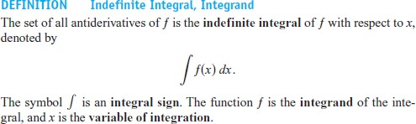


Indefinite Integrals and the Substitution Rule
EXAMPLE 1: Evaluate
Solution:

Slide 4
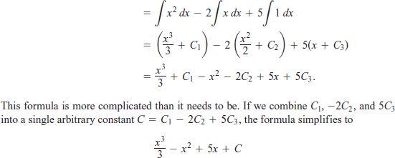

Slide 5
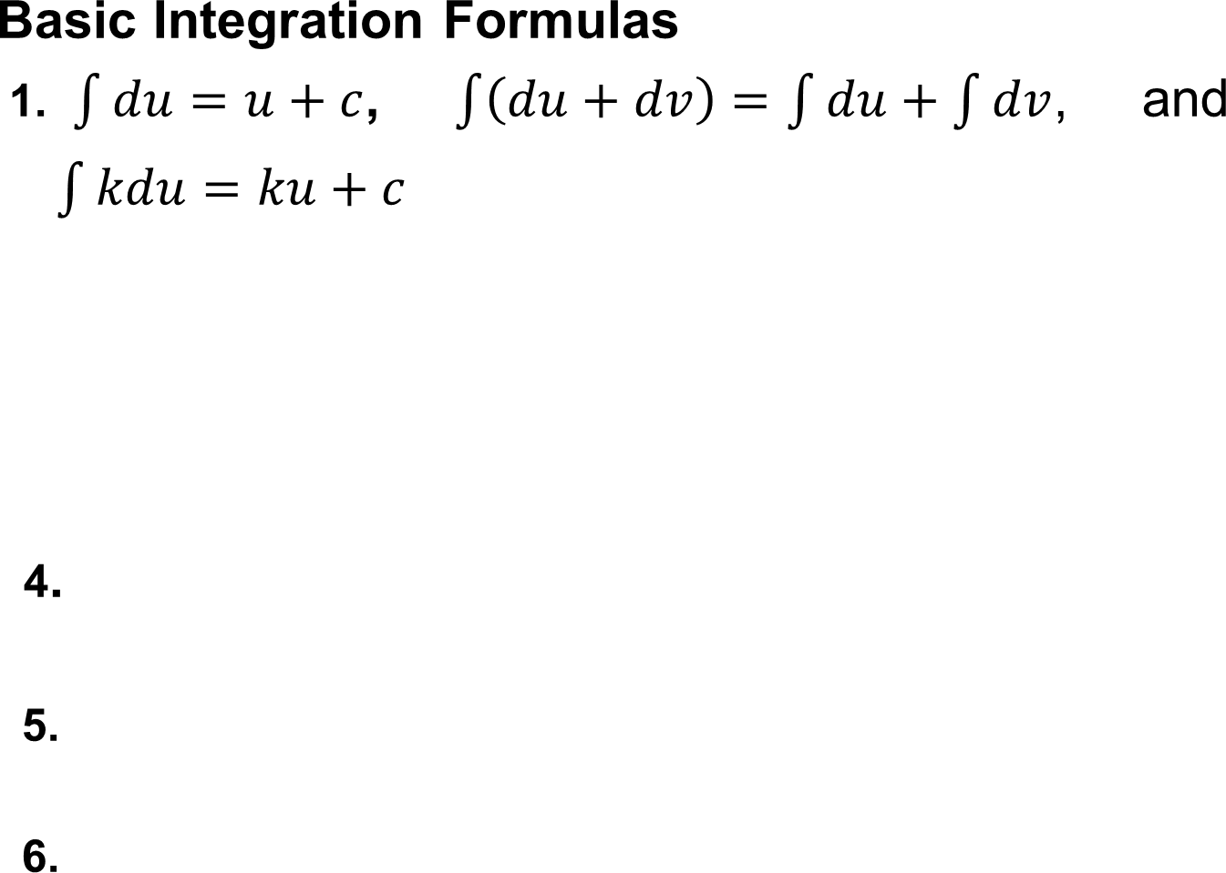
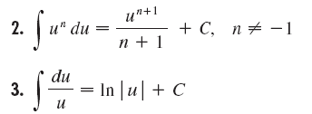




Slide 6





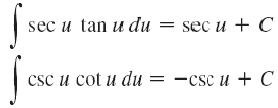
7.
8.
9.
10.
11.
12.
13.

Slide 7
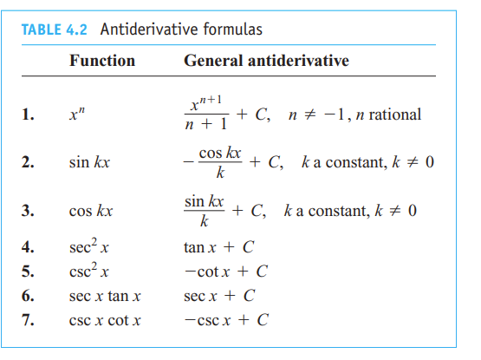
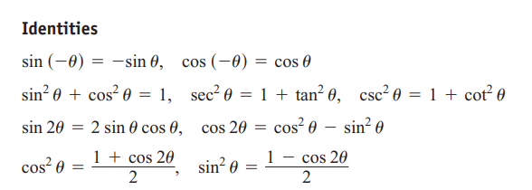

Slide 8
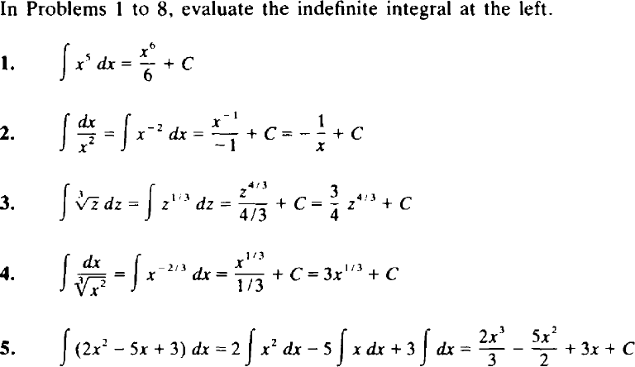

Slide 9
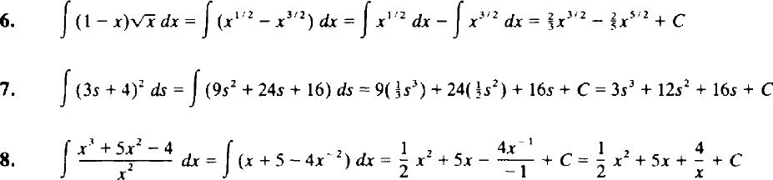

Slide 10

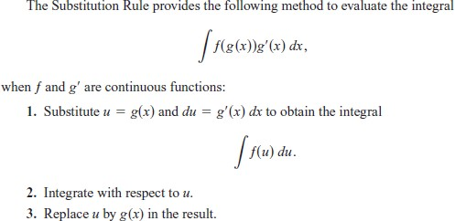
The Substitution Rule
Substitution: Running the Chain Rule Backwards

Slide 11


Slide 12
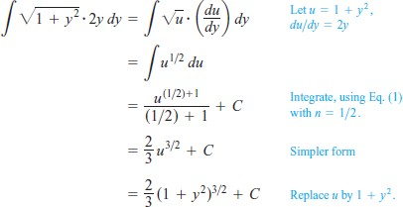
Using the Power Rule
EXAMPLE 1:

Slide 13
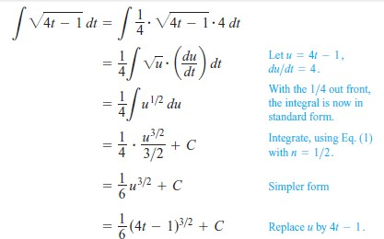
EXAMPLE 2 : Adjusting the Integrand by a Constant

Slide 14
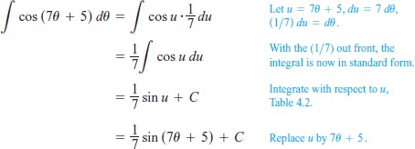
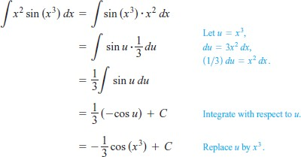
EXAMPLE 3: Using Substitution
EXAMPLE 4:
Using Substitution

Slide 15
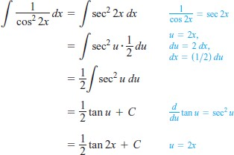
Using Identities and Substitution
EXAMPLE 5:

Slide 16

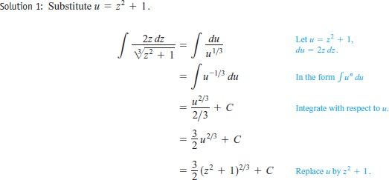
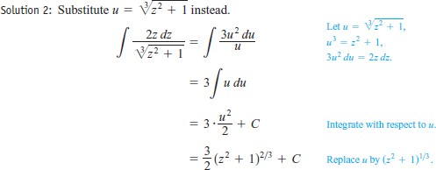
EXAMPLE 6: Using Different Substitutions, Evaluate

Slide 17
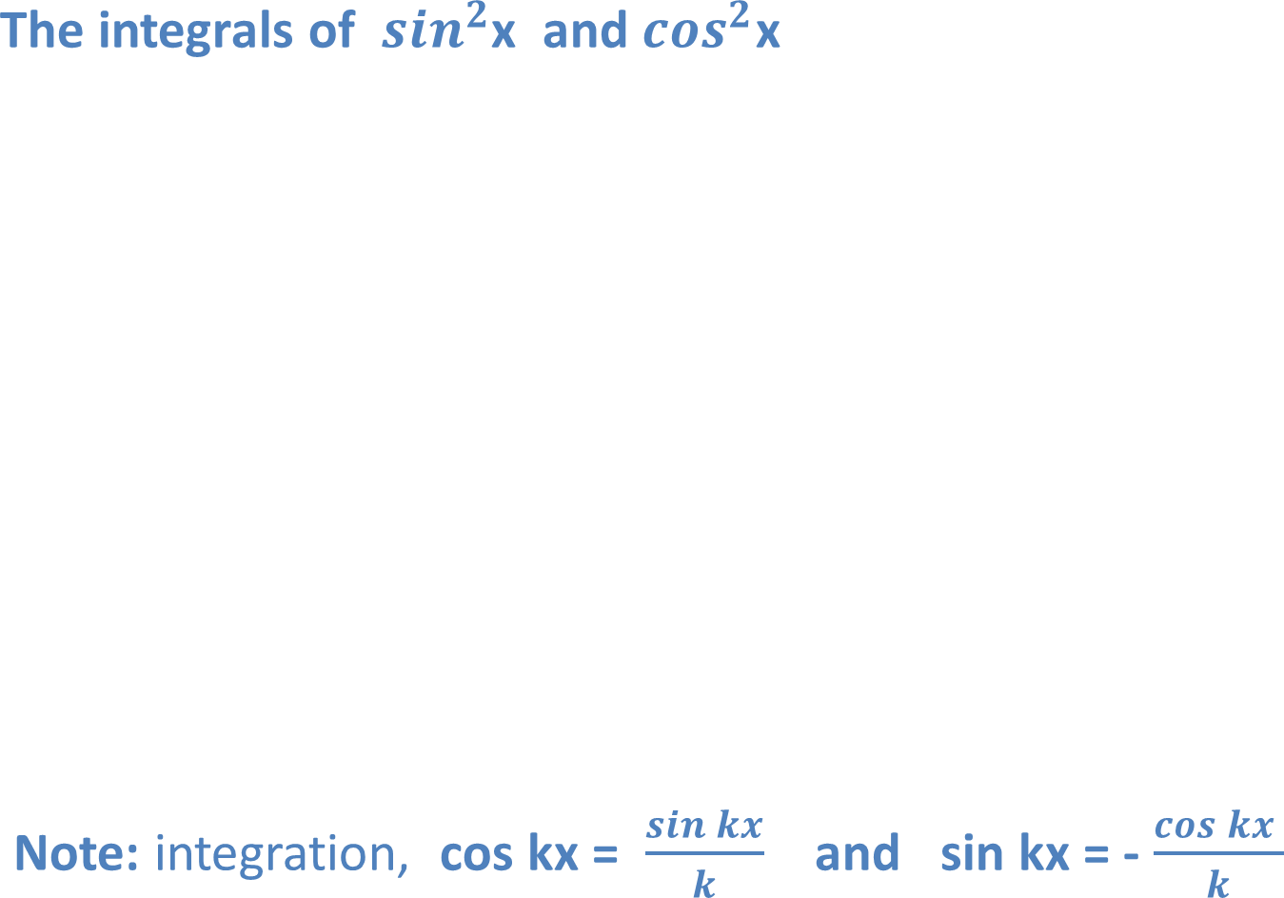
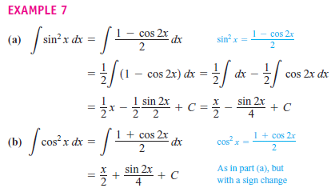

Slide 18

















EXERCISES 5
1. Evaluate the indefinite integrals in Exercises 1–12 by using the given substitutions to reduce the integrals to standard form.
2. Evaluate the integrals in Exercises 13–48.

